Slide 1
Lesson 1
Introduction to MS SQL Server

Slide 2
Querying MS SQL Server
Create Database Objects (25%)
Create and alter tables using T-SQL syntax
Create and alter views
Create and modify constraints on tables;
Create and alter DML triggers.
Work with Data (35%)
Query data by using SELECT statements.
Implement sub-queries.
Implement data types.
Implement aggregate queries.

Slide 3
Modify Data (20%)
Create and alter Stored Procedures
Modify data by using INSERT, UPDATE, and DELETE
Combine datasets.(UNION ,MERGE )
Work with functions.
Troubleshoot & Optimize (20%)
Manage Transactions
Mark a transaction; commit, and rollback;
Implicit /explicit transactions;
Isolation levels; scope and type of locks
Use cursors; impact of scalar UDFs
Combine multiple DML operations
Implement error handling. Implement try/catch/throw;
Optimize queries. understand statistics; read query plans;
Plan guides; DMVs; hints; statistics IO;

Slide 4
T-SQL
SQL
Relational Model
Set Theory
Predicate Logic

Slide 5
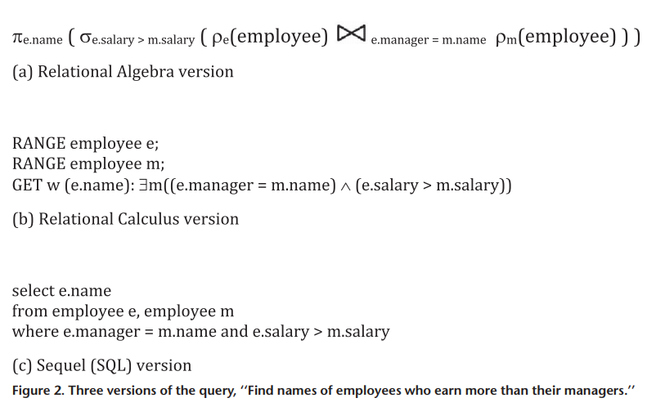
Relational Algebra vs SQL

Slide 6
History of SQL Server
Microsoft and Sybase released version 1.0 in 1989. However, the partnership between these two ended in the early 1990s.
Microsoft maintained ownership rights to the name SQL Server.
Since the 1990s, subsequent versions of SQL Server have been released including
SQL Server 2000, 2005, 2008, 2012, 2014, 2016, 2017, and 2019.

Slide 7
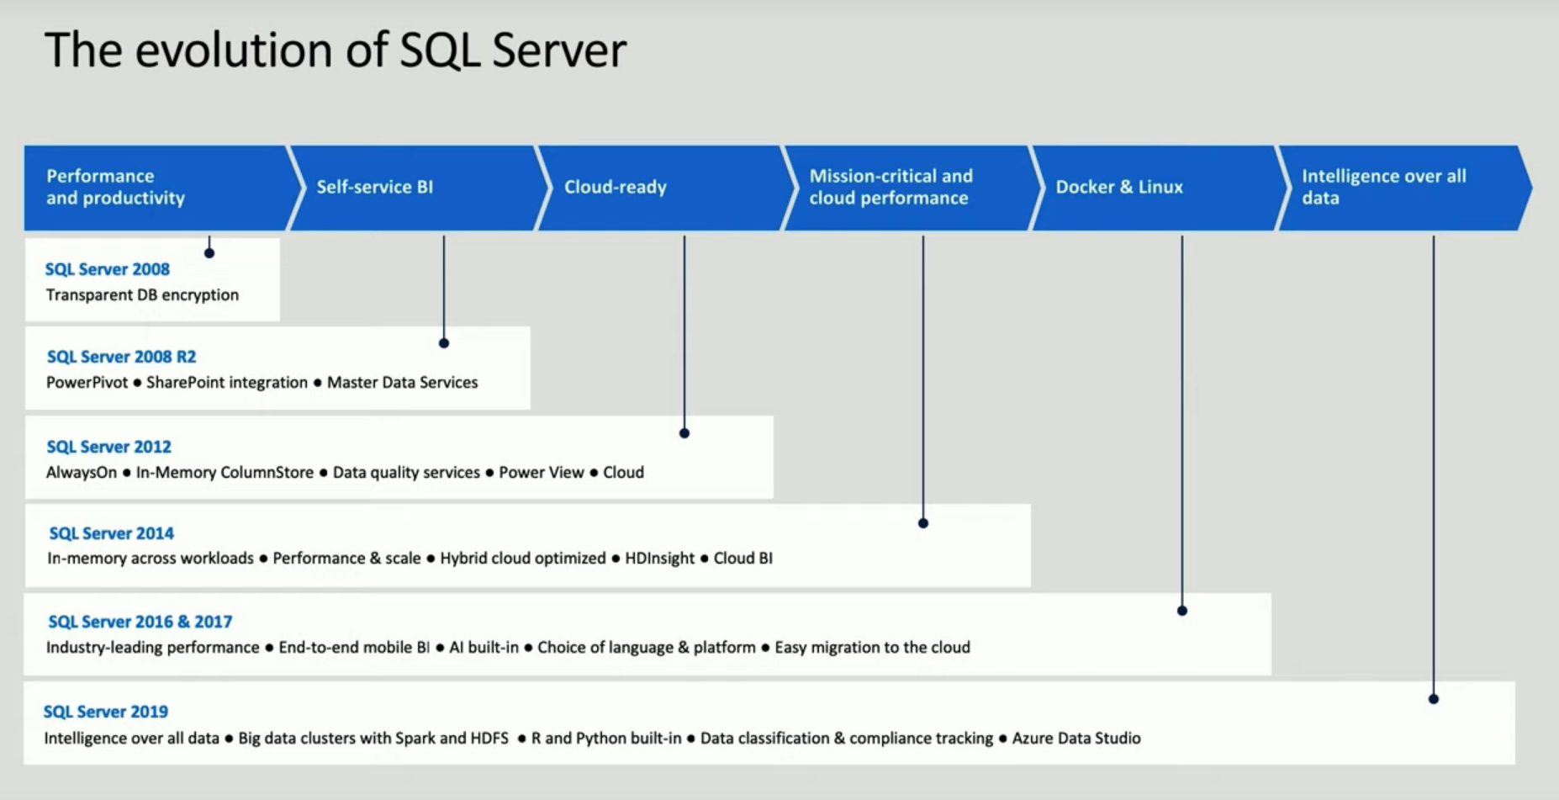

Slide 8
SQL Server Editions
Enterprise edition
Standard edition
Web Edition
Developer edition
Express edition

Slide 9
Enterprise Edition
Maximum number of cores is subject to the OS being used
Advanced high availability can be achieved with AlwaysOn
Support for the new columnstore indexing feature
Advanced auditing CDC
Transparent Data Encryption (TDE)
Compression and partitioning
Includes all of the BI edition’s features and capabilities:
Reporting
Analytics
Multidimensional BI semantic model
Data-quality services
Master data services
In-memory tabular BI semantic model
Self-service business intelligence

Slide 10
Standard Edition
Spatial support
FileTable
Policy-based management
Corporate business intelligence
Reporting
Analytics
Multidimensional BI semantic model
Basic high availability can be achieved with AlwaysOn 2 Node Failover Clustering
Up to 24 cores, up to 128 GB of RAM, one virtual machine, and two failover clustering nodes

Slide 11
Developer Edition
The Developer edition includes all of the features and functionality found in the Enterprise edition

Slide 12
Web Edition
Similar to Express edition
Doesn’t have database size restrictions,
Supports up to 4 CPU or 16 cores
Supports up to 64 GB of memory

Slide 13
Express Edition
Limited to one processor or 4 cores
1 GB of memory,
Maximum database size of 10 GB.
Express is integrated with Microsoft Visual Studio

Slide 14
SQL Server Instances
Each instance of SQL Server contains its own set of :
Databases
Security credentials
Configuration settings
Windows services
All other SQL Server objects.
Max 50 instances of SQL Server on a single machine, one default and the rest named instance

Slide 15
Default instance connection
Uses the machine name to which the instance is installed.
Named instance connection
Uses the combination of the machine name and instance name, such as
<machinename>\<instancename>

Slide 16
Reasons for more than one instance
Quality Assurance testing or Development
Need multiple service pack or patch levels
Different groups of administrators are allowed to access only a subset of databases within an organization
Multiple sets of SQL Server configuration options required

Slide 17
SQL Server Configuration Manager
SSCM is responsible for managing SQL Server services and protocols. i.e
Starting, stopping, pausing, and restarting a service
Changing service accounts and service account passwords
Managing the start-up mode of a service
Configuring service start-up parameters

Slide 18
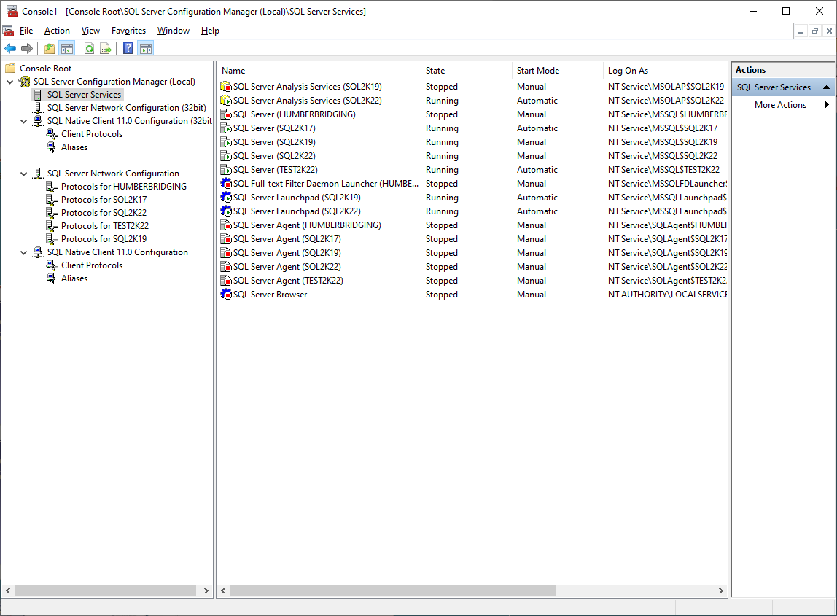
SQL Server Configuration Manager

Slide 19
Authentication Modes
Authentication mode for SQL Server can be set to either
Windows Only (integrated security)
Windows and SQL Server (mixed mode)

Slide 20
SQL Server Management Studio
SSMS is an integrated environment for
Accessing
Configuring,
Managing,
Administering
Developing
all components of SQL Server.

Slide 21
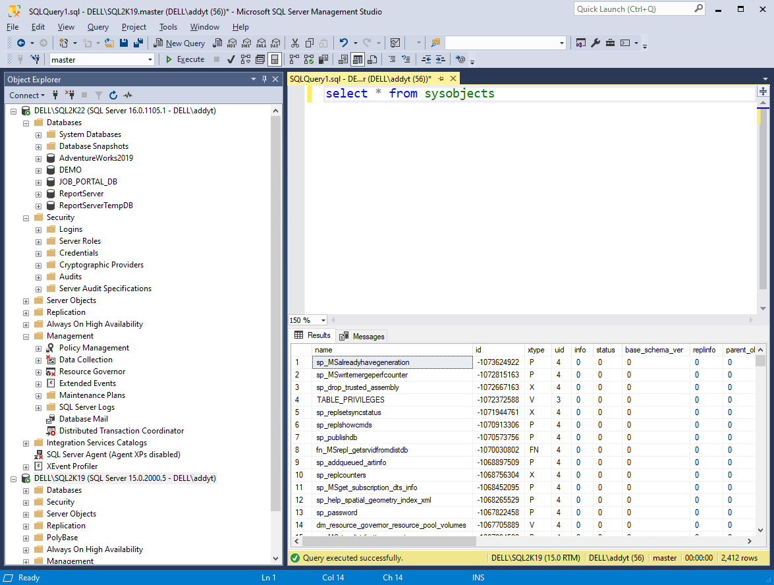
Microsoft SQL Server Management Studio

Slide 22
Transact-SQL
Transact-SQL (TSQL) is the language used to create objects and access data in Microsoft SQL Server
TSQL statement are divided into two distinct parts :
Data Manipulation Language
Data Definition Language

Slide 23
Data Manipulation Language (DML) is part of the TSQL language that allows insert, modify, and delete data in tables
The core DML statements are INSERT, UPDATE, DELETE, and MERGE.
INSERT INTO Produce VALUES
(1,'Tomato','Vegetable'),
(2,'Pear', 'Fruit'),
(3,'Apple', 'Fruit');

Slide 24
Data Definition Language (DDL) is a part of TSQL that deals with creating database objects
DDL statements are used to CREATE, ALTER, and DROP a SQL Server database object, such as a table, view, or stored procedure
CREATE TABLE Produce
(ProductID int PRIMARY KEY,
ProductName varchar (50),
ProductType varchar (20))

Slide 25
The SQL Server Management Studio (SSMS) user interface allows you to create an underlying DDL statement using the appropriate GUI component
Not all functionality is available within the user interface!!!

Slide 26
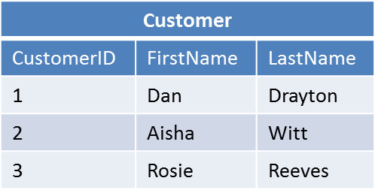
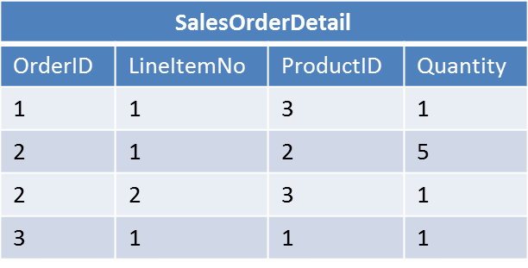
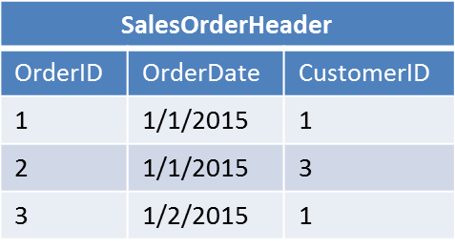
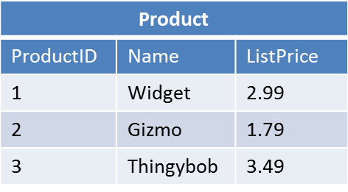
Most relational databases are normalized, with relationships defined between tables through primary and foreign keys

Slide 27
Working with NULL values
A NULL (value!) is the absence of data in a column.
When the ANSI_NULLS setting is set to ON, the default configuration, you cannot equate values to NULL.
If you try, the server returns “unknown”.

Slide 28
SET ANSI_NULLS OFF;
SELECT DISTINCT region
FROM Production.Suppliers
WHERE region <> NULL;
Same Result
SELECT DISTINCT region
FROM Production.Suppliers
WHERE region IS NOT NULL;
SET ANSI_NULLS ON;
SELECT DISTINCT region
FROM Production.Suppliers
WHERE region <> NULL;
Unknown

Slide 29
Logical Query processing order
The logical query processing order is different from the order you write queries.
SELECT Country, HireDate
FROM HR.Employees
WHERE HireDate >= '20030101'
GROUP BY Country, HireDate
HAVING COUNT(*) > 1
ORDER BY country;

Slide 30
Query Execution Order (Without UNION)
Clause | Result
FROM, JOIN, APPLY, and ON | The join is executed and the first query filter (the ON clause) is applied.
WHERE | The second query filter is applied.
GROUP BY and aggregate functions | Grouping and aggregation calculations are performed.
HAVING | The third query filter (filtering of the results of aggregate functions) is applied.
SELECT | Columns that should be returned by the query are selected.
ORDER BY | Results are sorted.
TOP | The fourth query filter is applied;
FOR XML | The tabular result returned by the SELECT statement is converted to XML

Slide 31
Query Execution Order (With UNION)
Clause | Result
FROM, JOIN, APPLY, and ON | The join is executed and the first query filter (the ON clause) is applied.
WHERE | The second query filter is applied.
GROUP BY and aggregate functions | Grouping and aggregation calculations are performed.
TOP | The fourth query filter is applied;
UNION & SELECT | Columns that should be returned by the query are selected.
ORDER BY | Results are sorted.
FOR XML | The tabular result returned by the SELECT statement is converted to XML

Slide 32
A query to retrieve all employees that were hired in or after the year 2003.
SELECT Country, YEAR(HireDate) AS YearHired, COUNT(*) AS NumEmployees
FROM HR.Employees
WHERE HireDate >= '20030101'
GROUP BY Country, YEAR(HireDate)
HAVING COUNT(*) > 1
ORDER BY Country, YearHired DESC;

Slide 33
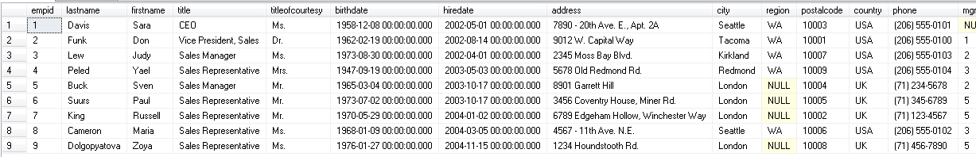
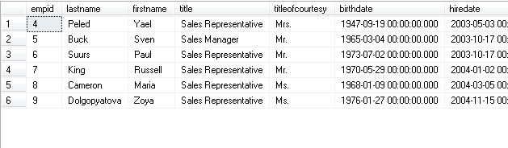
SQL Server first evaluates the from clause
Then the WHERE clause is evaluated

Slide 34
This is why you can not refer to a column alias in WHERE clause
SELECT Country,
YEAR(HireDate) AS YearHired
FROM HR.Employees
WHERE YearHired >= 2003;
Invalid

Slide 35
Then the GROUP BY Clause is evaluated
SELECT Country, YEAR(HireDate) AS YearHired, COUNT(*) AS NumEmployees
FROM HR.Employees
WHERE HireDate >= '20030101'
GROUP BY Country, YEAR(HireDate)
Group Group Detail Detail Detail
Country YEAR(hiredate) empid country hiredate
-------- -------------- ------ ------- ---------------
UK 2003 5 UK 2003-10-17
6 UK 2003-10-17
UK 2004 7 UK 2004-01-02
9 UK 2004-11-15
USA 2003 4 USA 2003-05-03
USA 2004 8 USA 2004-03-05

Slide 36
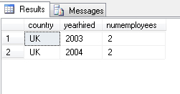
Filter Rows Based on the HAVING Clause
group group detail detail detail
country YEAR(hiredate) empid country hiredate
-------- -------------- ------ ------- ---------------
UK 2003 5 UK 2003-10-17
6 UK 2003-10-17
UK 2004 7 UK 2004-01-02
9 UK 2004-11-15
Then SELECT Clause is evaluated

Slide 37
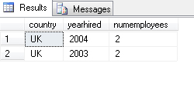
Finally handle presentation Ordering
SELECT Country, YEAR(HireDate) AS YearHired, COUNT(*) AS NumEmployees
FROM HR.Employees
WHERE HireDate >= '20030101'
GROUP BY Country, YEAR(HireDate)
HAVING COUNT(*) > 1
ORDER BY Country, YearHired DESC;

